Slide 1

02-04-02
Rescue ROBOT Vincent
SAVING PRIVATE
Sun wukong
(拯救孙悟空)
Hu Yidi, Li Jiawei, Liu Tianhang, Wang Jiannan, Lim Jit Wei

Slide 2
Once upon a time…

Slide 3
The Monkey King is trapped under Five Fingers Mountain

Slide 4
The monk wants to rescue the Monkey King, his apprentice, but it is very hard for him to achieve that…

Slide 5
The monk asks for Buddha’s help, and then Buddha gives him Vincent from the Great Land of Technology !
Picture of Vincent

Slide 6
In the Great Land of Technology (aka modern world)
Disasters like earthquakes can cause great losses. Rescue missions in those dangerous environments are inaccessible for humans.

Slide 7
2008 China Wenchuan earthquake
70,000 lives lost
3,750,000 injured
45 million affected
22 rescue team members lost

Slide 8
With the advancement of technology…
Solutions such as rescue robots have been developed to perform rescue missions

Slide 9
Vincent is a rescue robot
self-navigate through disaster-stricken areas
Monitor and report environmental variables, such as temperature, humidity and atmospheric components
Mark current locations
Stop at marked locations
Backtrack to starting point through the same route
Establish video live-stream of surroundings
Establish tele-communications between victims and rescuers

Slide 10

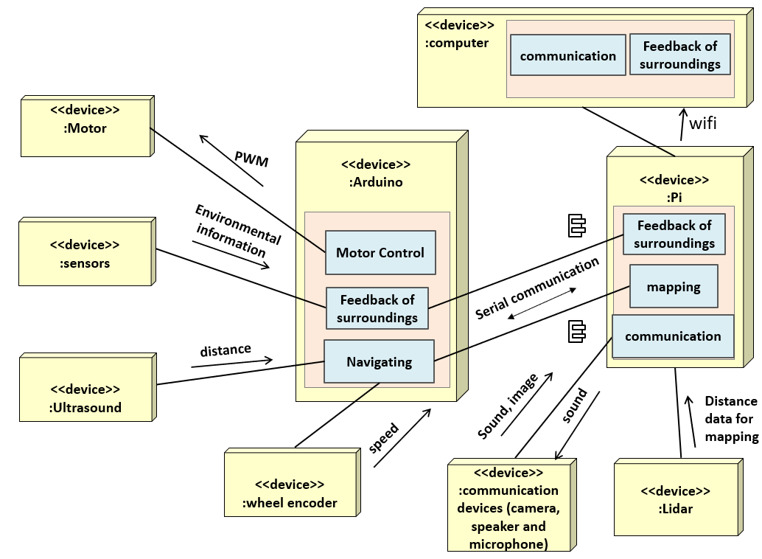
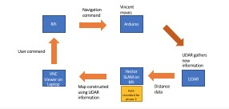
State of art
System architecture
Component design
Jiawei & Tianhang
Jiannan
Jit Wei

Slide 11
Let me tell you…
What is technology like in the land where Vincent come from?
Before using Vincent to rescue his apprentice, the monk has a few questions to ask…

Slide 12
Review of State of the Art

Slide 13
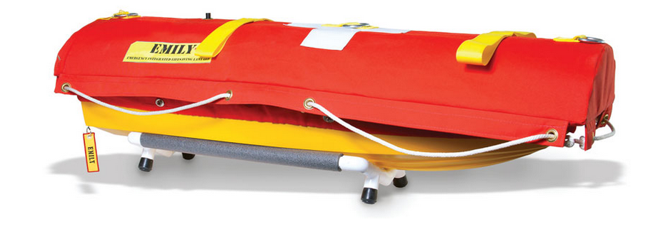
EMILY is a Tele-Operating rescue robot

Slide 14
Equipped with Ropes

Slide 15
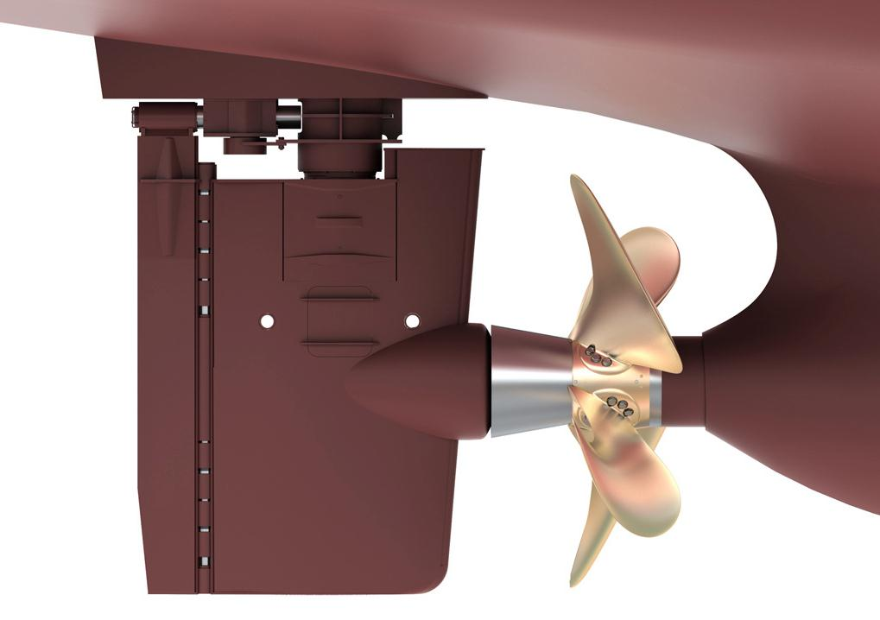

Powered by Jet Pump

Slide 16


One Charge, 10 km to go

Slide 17
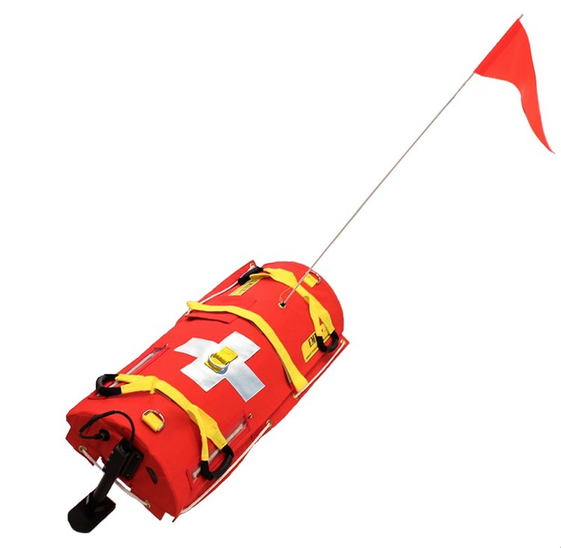
Sonar EMILY can avoid collision

Slide 18
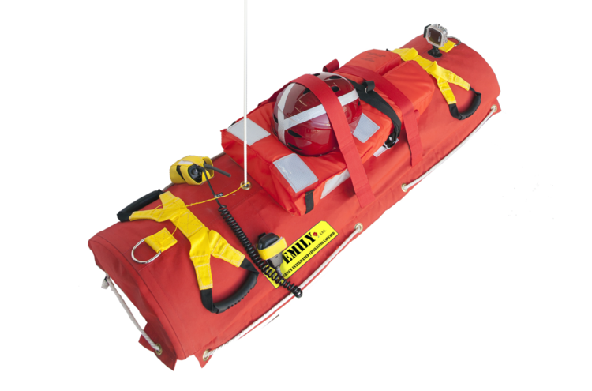
Swift Water Rescue
Camera
VHF Radio
Helmet
Life Jacket

Slide 19
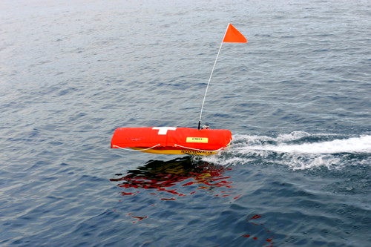

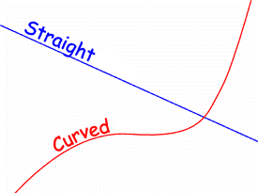
Better than human lifeguard
VS

Slide 20
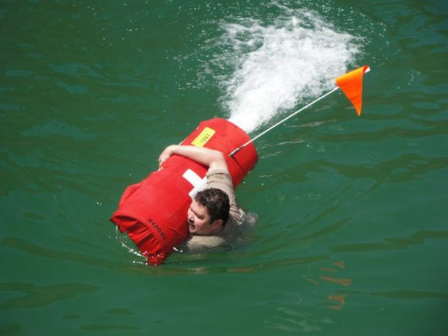
Unable to save unconscious swimmers
Grab and Hold

Slide 21
Let me tell you about the system architecture…
How is Vincent made?
Before using Vincent to rescue his apprentice, the monk has a few questions to ask…

Slide 22
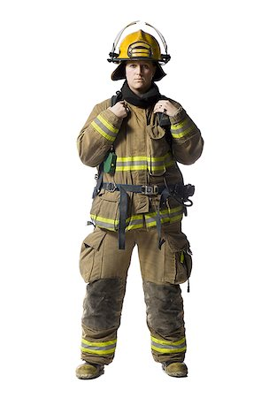
OUR SYSTEM ARCHITECTURE
Notes:
Thank you Tianhang. So I’ll be taking over from here to introduce to you regarding the system architecture of our robot Vincent. Here is a block diagram of it. At the center we have raspberry pi as our computer and Arduino uno as our microprocessor in use, operator’s computer sends commands and receive data from the Raspberry pi . We also have multiple distinct functional units such as different sensors, Lidar, Camera unit and telecommunication unit, to perform different functions for the Vincent robot. Some are connected to Pi and some to Arduino. If you are to treat the whole robot system as an actual rescue specialist, a human being, then these different components can all be matched to the respective parts of the human body that enables the whole human system to perform his work. Let’s go through them one by one.

Slide 23
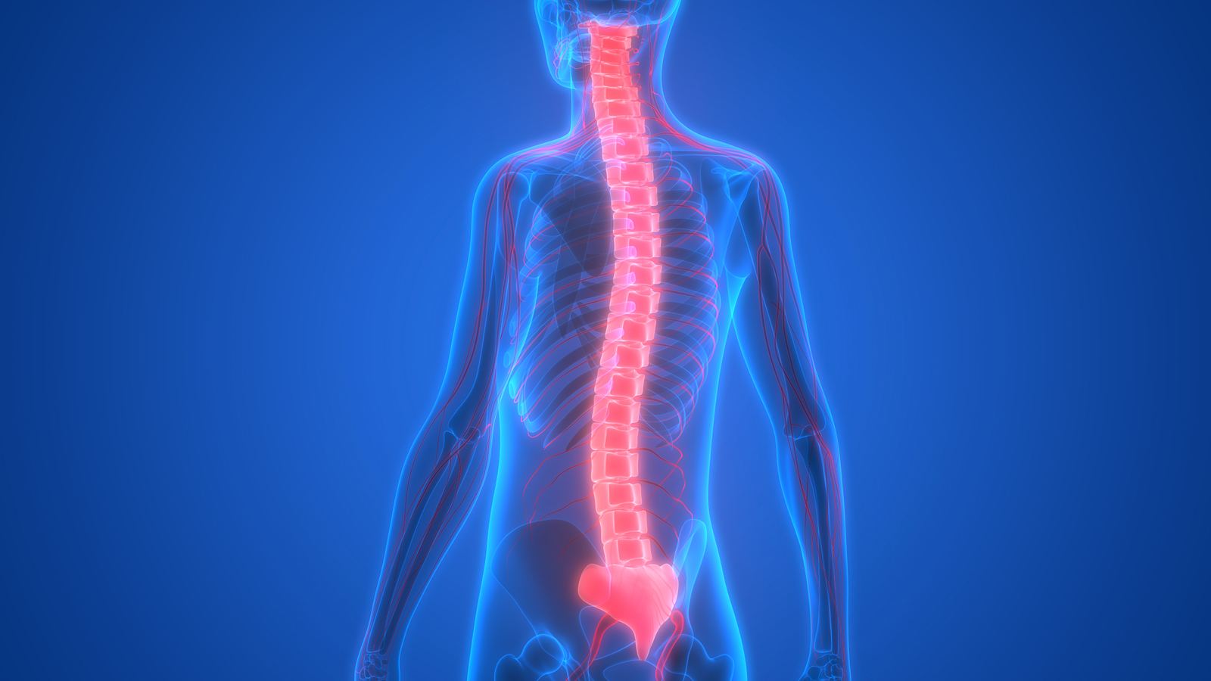
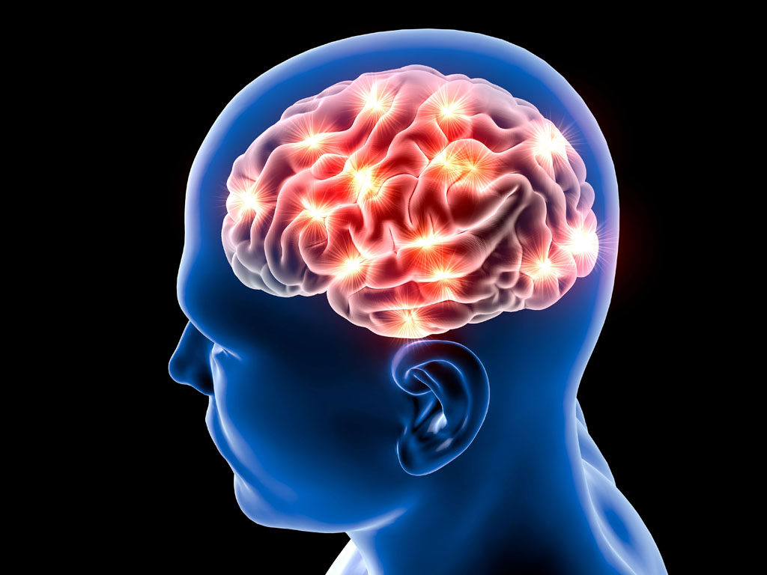
<<device>>
:computer
communication
Feedback of surroundings
<<device>>
:Motor
wifi
<<device>>
:Arduino
PWM
<<device>>
:Pi
<<device>>
:sensors
Feedback of surroundings
Motor Control
Environmental information
Serial communication
mapping
Feedback of surroundings
communication
Navigating
<<device>>
:Ultrasound
distance
sound
Distance data for mapping
Sound, image
Subordinary neural center of the central nervous system
Receive and transmit pulses from and to the sensory units
Central organ of the nervous system
Overall in charge
<<device>>
:wheel encoder
speed
<<device>>
:communication devices (camera, speaker and microphone)
<<device>>
:Lidar

Slide 24
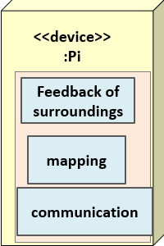
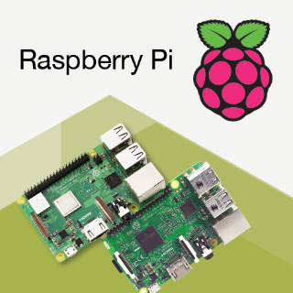

Slide 25
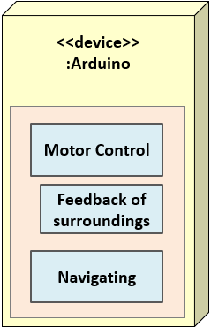
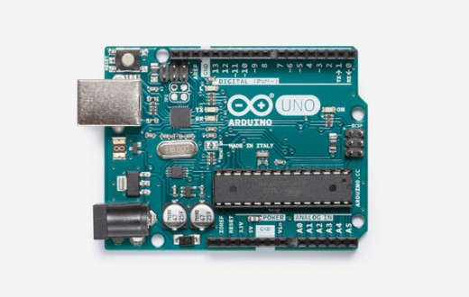

Slide 26
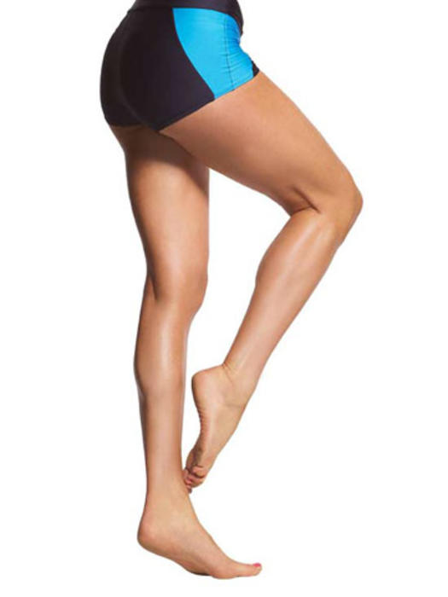


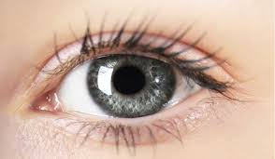
<<device>>
:Motor
<<device>>
:Arduino
PWM
<<device>>
:Pi
<<device>>
:sensors
Feedback of surroundings
Motor Control
Environmental information
Serial communication
mapping
Feedback of surroundings
communication
Navigating
<<device>>
:Ultrasound
distance
sound
Distance data for mapping
Sound, image
<<device>>
:wheel encoder
speed
<<device>>
:communication devices (camera, speaker and microphone)
<<device>>
:Lidar

Slide 27
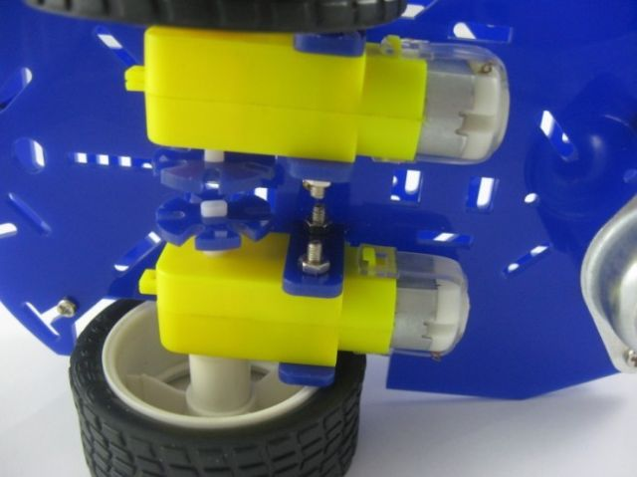
<<device>>
:Motor
Notes:
Magician chassis gearmotor with a 48:1 gear
DRV-8833 Dual Motor Driver Carrier

Slide 28
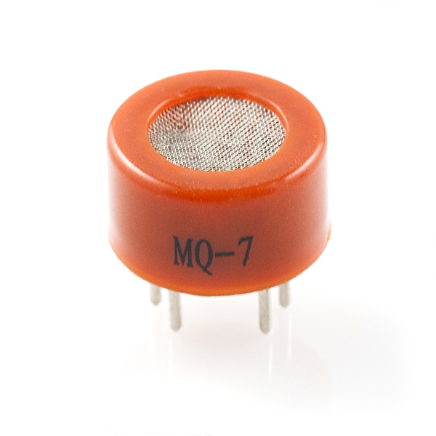
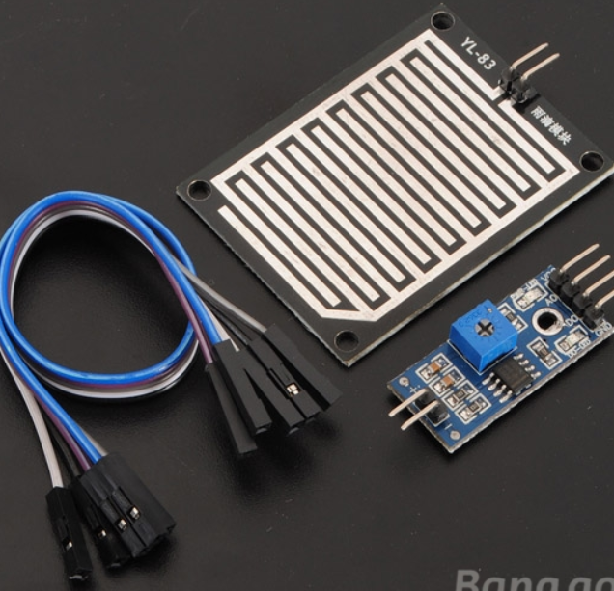
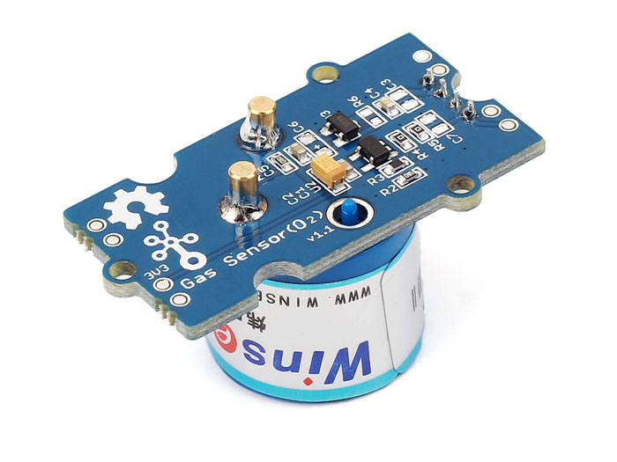
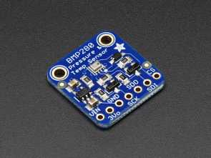
<<device>>
:sensors
Carbon Monoxide sensor MQ7
raindrop sensor
BMP280 barometer pressure and altitude sensor
Oxygen level sensor ME2-O2-Ф20
Notes:
Carbon monoxide sensor
Raindrop sensor
BMP280 barometer pressure and altitude sensor
Oxygen level sensor

Slide 29
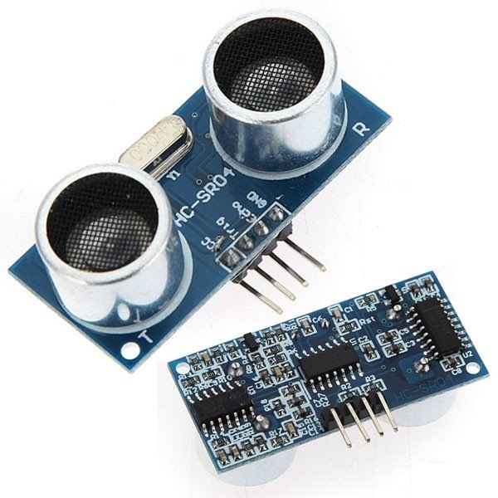
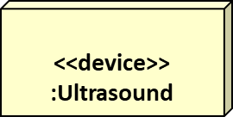
Ultrasonic sensor module HC-SR04
Notes:
Ultrasonic sensor

Slide 30
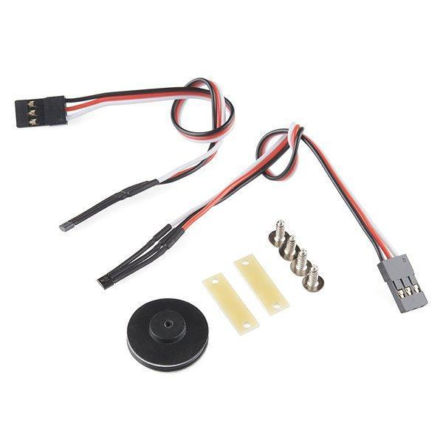
<<device>>
:wheel encoder
Dagu simple hall-effect magnetic wheel encoder kit RS030

Slide 31
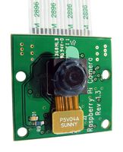


<<device>>
:communication devices (camera, speaker and microphone)
Raspberry Pi camera board
speaker
microphone

Slide 32
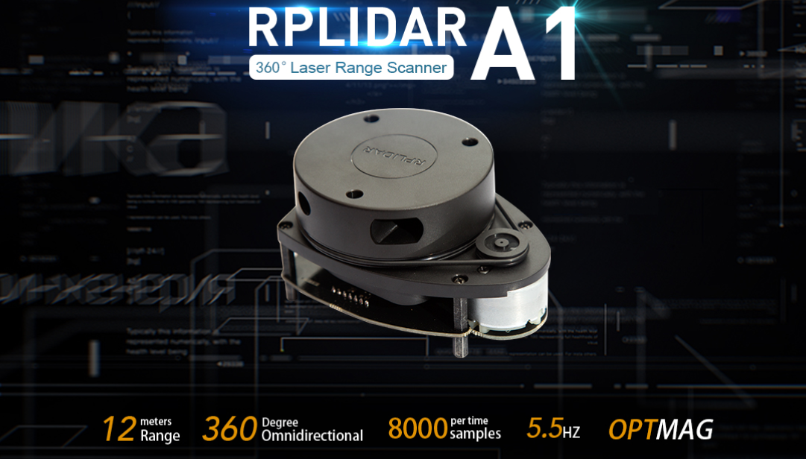
<<device>>
:Lidar
RPLIDAR A1 by SLAMTECH
Notes:
Lidar

Slide 34
Let me tell you about the component design…
How does Vincent work?
I don’t want it to hurt my monkey…
Before using Vincent to rescue his apprentice, the monk has a few questions to ask…

Slide 35
Vincent is tele operated in phase 1
Vincent moves
Navigation command
RPi
Arduino
User command
LIDAR gathers new information
VNC Viewer on Laptop
Hector SLAM on RPi
LIDAR
Map constructed using LIDAR information
Distance
data
Path recorded for phase 2
Notes:
TODO:
Simplify the description
Add transitions
LIDAR(eyes) – distance – sent through microUSB
Hector SLAM on Rpi(Brain) – (simultaneous localization and mapping), distance -> map, path saved for phase 2 , uses rviz package in ROS
VNC Viewer on Laptop – broadcast Rpi screen to the laptop, give commands from laptop (i.e. Mark location, move forward), marked location saved for phase 2 – sent through wifi
Rpi – translates the user command and sends to arduino – sent through serial communication
Arduino(CNS) – output to the motor
Advantage of Hector slam (optional)
Things that can be added:
Wheel encoders
Mark location

Slide 36
Vincent backtracks autonomously in phase 2
Navigation command
Path recorded in phase 1
RPi
Arduino
Vincent backtracks
“Start backtracking” command sent by user
LIDAR gathers odometry information
Current location of Vincent
Hector SLAM on RPi
LIDAR
VNC Viewer on Laptop
Odometry data
Notes:
TODO:
Simplify the description
Add transitions
VNC Viewer on Laptop – wait for the “start backtracking” command from the user, tell Rpi to start the backtracking – sent through wifi
Rpi – backtracks using the location of Vincent, path from phase 1, and the marked locations - sent through serial communication
Arduino(CNS) – output to the motor, stop Vincent at the marked location and play the beacon(light up LEDs, play weird sounds or blow up Pi)
LIDAR(eyes) – gathers information about the current location
Hector SLAM on Rpi(Brain) – figure out current location on the map
Things to add:
What is odometry data

Slide 37
Conclusion
Vincent is a robot that models the real search and rescue robot.
It mainly works to
Explore the arena
Obtain a map of the area
Detect victims and mark location.
Backtrack
Q
Any questions before I go save my monkey?

